Slide 1
UNIT 8: More Practice With Optimization
For Live Session Assignment
Chad Madding

Slide 2
Problem 1
You need to buy some filing cabinets. You know that Cabinet X costs $10 per unit, requires six square feet of floor space, and holds eight cubic feet of files. Cabinet Y costs $20 per unit, requires eight square feet of floor space, and holds twelve cubic feet of files. And Cabinet Z costs $25 per unit, requires 9 square feet of floor space and holds 15 cubic feet of files. You have been given $140 for this purchase, though you don't have to spend that much. The office has room for no more than 72 square feet of cabinets. How many of which model should you buy, in order to maximize storage volume?
How would your optimal solution change if you were able to afford $185 for the purchase?
How would your optimal solution change if you decided you could stack all the cabinets which allowed you double the square feet requirement to 144 feet? (Assume your budget is back to $140.)

Slide 3
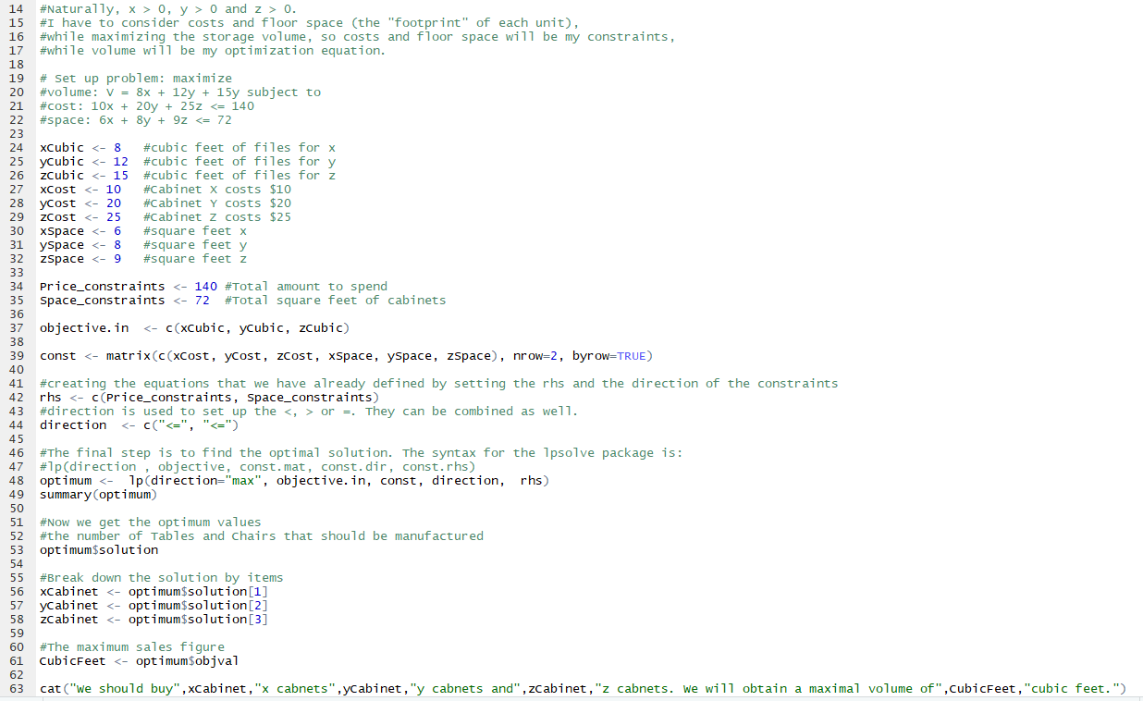
Problem 1 - Solution
How many of which model should you buy, in order to maximize storage volume?
> #Now we get the optimum values
> optimum$solution
[1] 9 0 2
We should buy 9 x cabinets 0 y cabinets and 2 z cabinets. We will obtain a maximal volume of 102 cubic feet.
How would your optimal solution change if you were able to afford $185 for the purchase?
We should buy 2 x cabinets 0 y cabinets and 6 z cabinets. We will obtain a maximal volume of 115 cubic feet.
How would your optimal solution change if you decided you could stack all the cabinets which allowed you double the square feet requirement to 144 feet? (Assume your budget is back to $140.)
We should buy 14 x cabinets 0 y cabinets and 0 z cabinets We will obtain a maximal volume of 112 cubic feet.

Slide 4
Problem 2
You have $12,000 to invest, and three different funds from which to choose. The municipal bond fund has a 7% return, the local bank's CDs have an 8% return, and the high-risk account has an expected (hoped-for) 12% return. To minimize risk, you decide not to invest any more than $2,000 in the high-risk account. For tax reasons, you need to invest at least three times as much in the municipal bonds as in the bank CDs. Assuming the year-end yields are as expected, what are the optimal investment amounts?
How would your optimal solution change if you decided you could tolerate more risk and could invest up to a third of your money in the high-risk account?

Slide 5
Problem 2 - Solution
How would your optimal solution change if you decided you could tolerate more risk and could invest up to a third of your money in the high-risk account?
We should invest 7500 dollars in the municipal bond fund, 2500 dollars in the local banks CDs and 2000 dollars in the high-risk account.
We should get an optimal return of 965 dollars.
How would your optimal solution change if you decided you could tolerate more risk and could invest up to a third of your money in the high-risk account?
We should invest 6000 dollars in the municipal bond fund, 2000 dollars in the local banks CDs and 4000 dollars in the high-risk account.
We should get an optimal return of 1060 dollars.
R Code may be found at:
https://github.com/cmadding/MSDS7374/blob/master/Invest.R

